Slide 1


Reasoning in Uncertain Situations
9.0 Introduction
9.1 Logic-Based Abductive Inference
9.2 Abduction: Alternatives to Logic
9.3 The Stochastic Approach to Uncertainty
9.4 Epilogue and References
9.5 Exercises
George F Luger
ARTIFICIAL INTELLIGENCE 6th edition
Structures and Strategies for Complex Problem Solving
Luger: Artificial Intelligence, 6th edition. © Pearson Education Limited, 2009
1

Slide 2
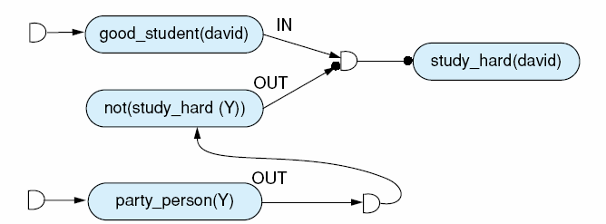
Fig 9.1 A justification network to believe that David studies hard.
Luger: Artificial Intelligence, 6th edition. © Pearson Education Limited, 2009
2

Slide 3
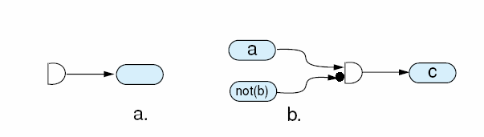
Fig 9.2 9.2(a) is a premise justification, and 9.2 (b) the ANDing of two beliefs, a and not b, to support c (Goodwin 1982).
Luger: Artificial Intelligence, 6th edition. © Pearson Education Limited, 2009
3

Slide 4
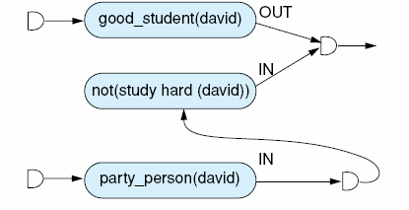
Fig 9.3 The new labelling of fig 9.1 associated with the new premise party_person(david).
Luger: Artificial Intelligence, 6th edition. © Pearson Education Limited, 2009
4

Slide 5
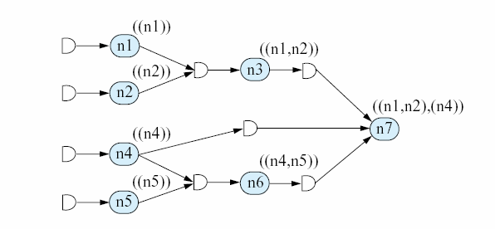
Fig 9.4 An ATMS labeling of nodes in a dependency network.
Luger: Artificial Intelligence, 6th edition. © Pearson Education Limited, 2009
5

Slide 6
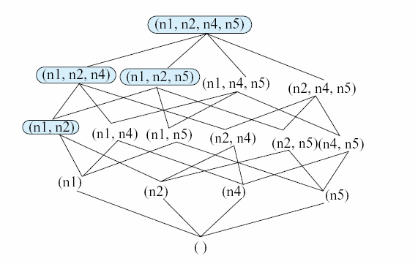
Fig 9.5 The lattice for the premises of the network of fig 9.4. Circled sets indicate the hierarchy inconsistencies, after Martins (1991)
Luger: Artificial Intelligence, 6th edition. © Pearson Education Limited, 2009
6

Slide 7
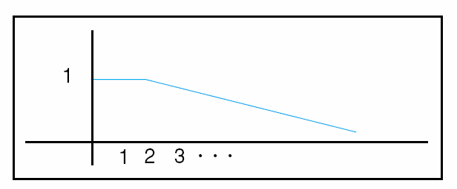
Fig 9.6 the fuzzy set representation for “small integers.”
Luger: Artificial Intelligence, 6th edition. © Pearson Education Limited, 2009
7

Slide 8
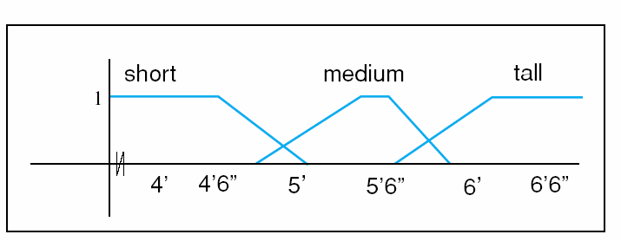
Fig 9.7 A fuzzy set representation for the sets short, medium, and tall males.
Luger: Artificial Intelligence, 6th edition. © Pearson Education Limited, 2009
8

Slide 9
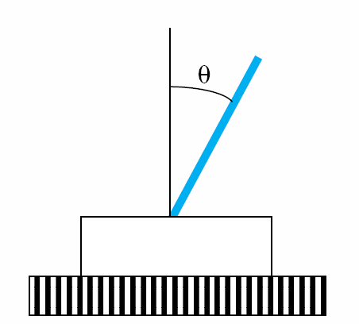
Fig 9.8 The inverted pendulum and the angle θ and dθ/dt input values.
Luger: Artificial Intelligence, 6th edition. © Pearson Education Limited, 2009
9

Slide 10
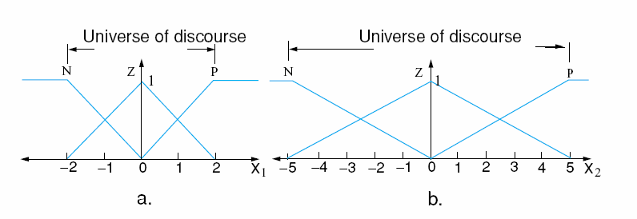
Fig 9.9 The fuzzy regions for the input values θ (a) and dθ/dt (b).
Luger: Artificial Intelligence, 6th edition. © Pearson Education Limited, 2009
10

Slide 11
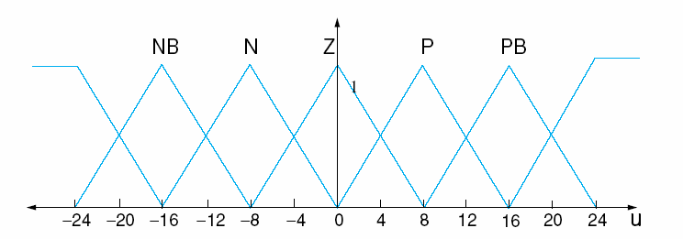
Fig 9.10 The fuzzy regions of the output value u, indicating the movement of the pendulum base.
Luger: Artificial Intelligence, 6th edition. © Pearson Education Limited, 2009
11

Slide 12
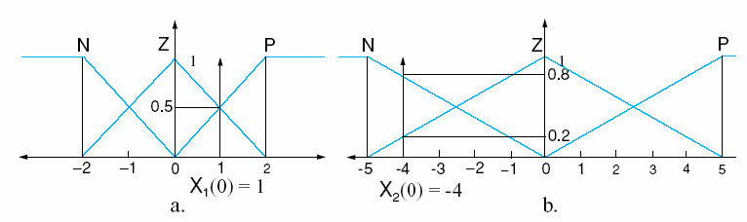
Fig 9.11 The fuzzificzation of the input measures X₁ = 1, X₂ = -4
Luger: Artificial Intelligence, 6th edition. © Pearson Education Limited, 2009
12

Slide 13
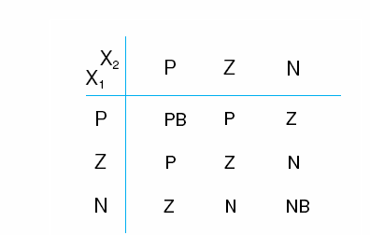
Fig 9.10 The Fuzzy Associative Matrix (FAM) for the pendulum problem. The input values are on the left and top.
Luger: Artificial Intelligence, 6th edition. © Pearson Education Limited, 2009
13

Slide 14
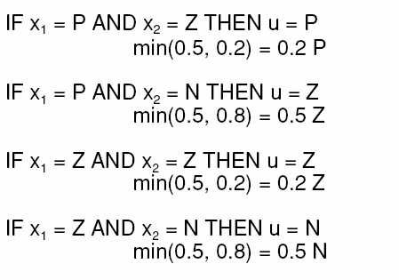
Luger: Artificial Intelligence, 6th edition. © Pearson Education Limited, 2009
14

Slide 15
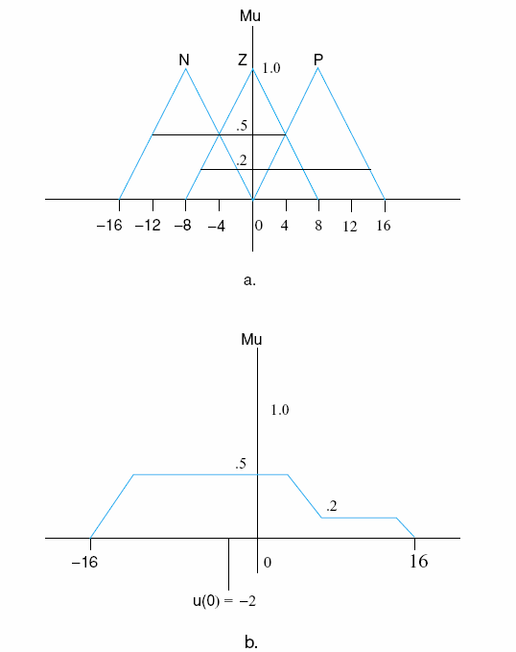
Fig 9.13 The fuzzy consequents (a) and their union (b). The centroid of the union (-2) is the crisp output.
Luger: Artificial Intelligence, 6th edition. © Pearson Education Limited, 2009
15

Slide 16
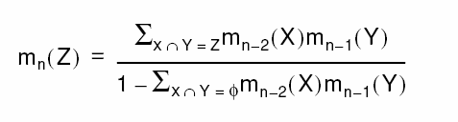
Dempster’s rule states:
Luger: Artificial Intelligence, 6th edition. © Pearson Education Limited, 2009
16

Slide 17
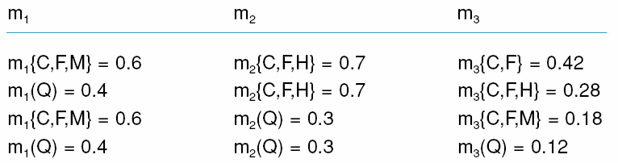
Table 9.1 Using Dempster’s rule to obtain a belief distribution for m₃ .
Luger: Artificial Intelligence, 6th edition. © Pearson Education Limited, 2009
17

Slide 18
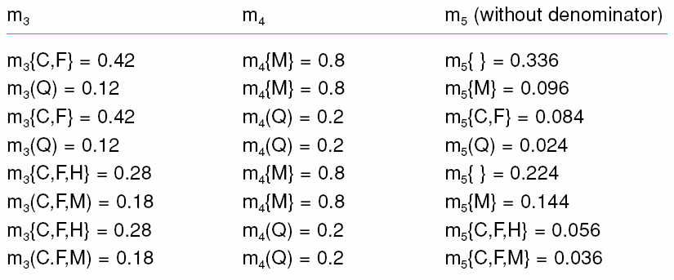
Table 9.2 Using Dempster’s rule to combine m₃ and m₄ to get m_{5.}
Luger: Artificial Intelligence, 6th edition. © Pearson Education Limited, 2009
18

Slide 19
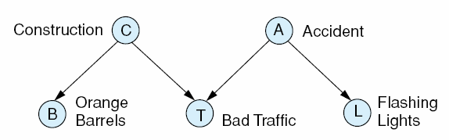
Fig 9.14 The graphical model for the traffic problem, first introduced in Section 5.3.
Luger: Artificial Intelligence, 6th edition. © Pearson Education Limited, 2009
19

Slide 20
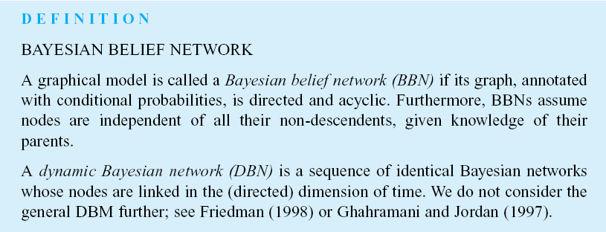
Luger: Artificial Intelligence, 6th edition. © Pearson Education Limited, 2009
20

Slide 21
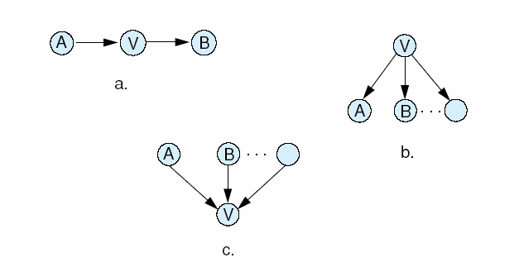
Fig 9.15 a is a serial connection of nodes where influence runs between A and B unless V is instantiated. 9.15b is a diverging connection, where influence runs between V’s children, unless V is instantiated. In 9.15c, a converging connection, if nothing is known about V the its parents are independent, otherwise correlations exist between its parents.
Luger: Artificial Intelligence, 6th edition. © Pearson Education Limited, 2009
21

Slide 22
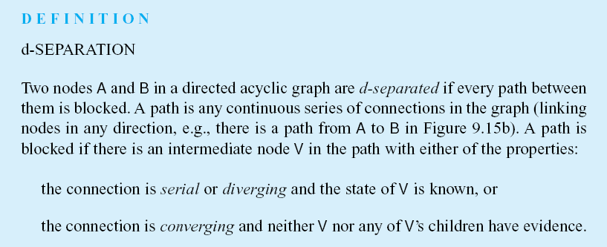
Luger: Artificial Intelligence, 6th edition. © Pearson Education Limited, 2009
22

Slide 23
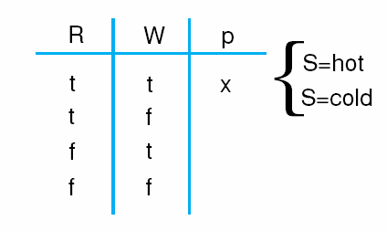
Table 9.4 The probability distribution for p(WS), a function of p(W) and p(R) given the effect of S. We calculate the effect for x, where
R = t and W = t.
Luger: Artificial Intelligence, 6th edition. © Pearson Education Limited, 2009
23

Slide 24
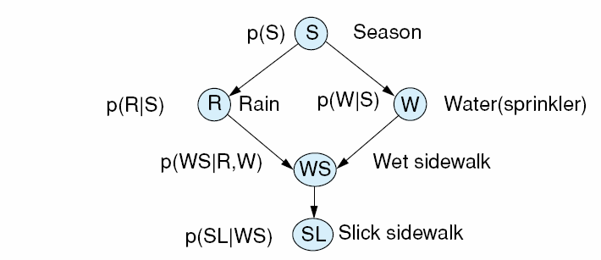
Fig 9.16 An example of a Bayesian probabilistic network, where the probability dependencies are located next to each node. This example is from Pearl (1988).
Luger: Artificial Intelligence, 6th edition. © Pearson Education Limited, 2009
24

Slide 25
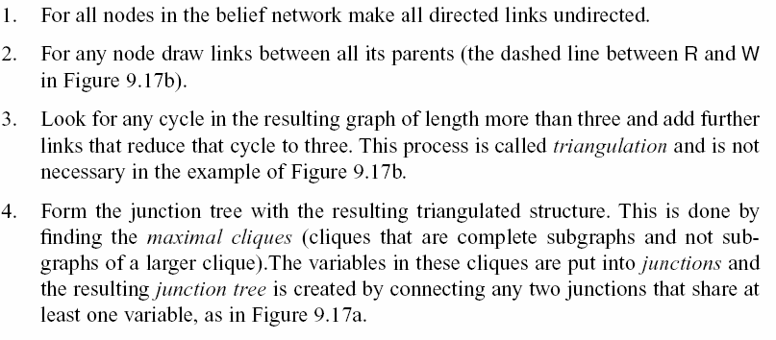
A junction tree algorithm.
Luger: Artificial Intelligence, 6th edition. © Pearson Education Limited, 2009
25

Slide 26
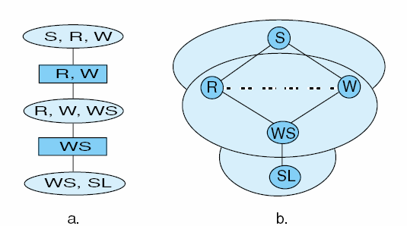
Fig 9.17 A junction tree (a) for the Bayesian probabilistic network of (b). Note that we started to construct the transition table for the rectangle R, W.
Luger: Artificial Intelligence, 6th edition. © Pearson Education Limited, 2009
26

Slide 27
t - 1 --> t --> t + 1
Figure 9.18. The traffic problem, Figure 9.14, represented
as a dynamic Bayesian network.
Luger: Artificial Intelligence, 6th edition. © Pearson Education Limited, 2009 27

Slide 28
Figure 9.19 Typical time series data to be analyzed by
a dynamic Bayesian network.
Luger: Artificial Intelligence, 6th edition. © Pearson Education Limited, 2009 28

Slide 29
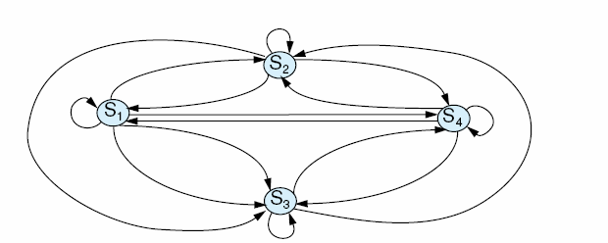
Fig 9.18 A Markov state machine or Markov chain with four states, s₁, ..., s₄
Luger: Artificial Intelligence, 6th edition. © Pearson Education Limited, 2009
29

Slide 30
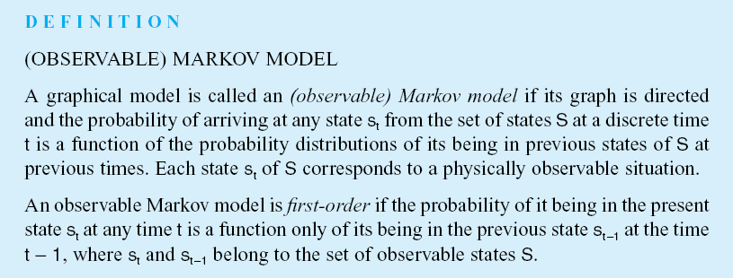
Luger: Artificial Intelligence, 6th edition. © Pearson Education Limited, 2009
30

Slide 31
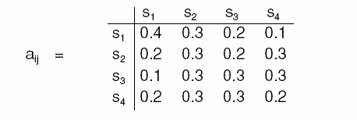
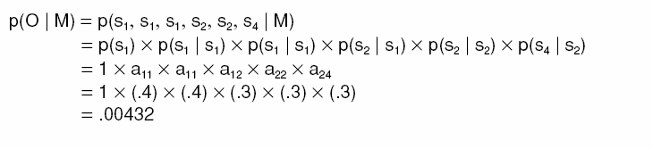
Luger: Artificial Intelligence, 6th edition. © Pearson Education Limited, 2009
31

Slide 32
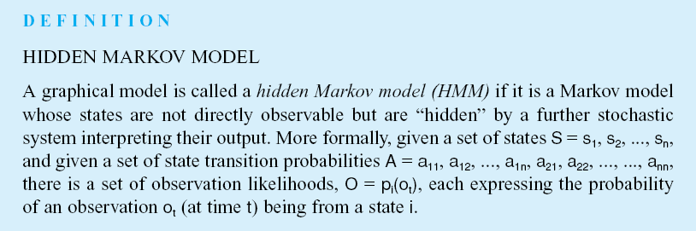
The HMM is discussed further in Chapter 13
Luger: Artificial Intelligence, 6th edition. © Pearson Education Limited, 2009
32

